Slide 1
Milestone 1
Due: Wednesday Oct. 12 at 11:00pm

Slide 2
Milestone 1
Due: Wednesday, Oct. 12 at 11:00pm (this the entire Milestone, including all Appendices)
Project Description
You and your team will improve/come up with a new design for a UI prototype for your chosen topic based on a current app
Your goal is to improve an application based on your topic and chosen device type. Milestone 1 focuses on performing a contextual inquiry that is conducted to first understand the user, their needs, and what they do and not on your design ideas.
The Milestone (template supplied on Brightspace) should be between 12-14 pages in length with the appendices.
This group assignment will be an accumulation of Lab 1 and each group members' Assignment 2 (individual), Lab2 and Lab 3.

Slide 3
Section 1 - Group Information (.5 page)
Project Title
Date
Group Name and Group members (name, BannerID and email address)

Slide 4
Section 2 - Purpose and Background (~2-2.5 pp)
Purpose – describe the topic area you are investigation (.5 page)
Objectives – 3-5 objectives that you hope to learn from doing this inquiry (~.5)
Literature Review and Application Assessment– using the individual group members' Assignment 2, write a comprehensive review of the current research/landscape of the topic area. (~1 pages). You should also include a summary of the app assessment you did between popular apps based on your topic to justify the app you chose to explore (~.5 page)
In Lab1 your group found relevant papers to your topic and produced themes that related to the papers. You should use that lab with each member's individual summaries to create your literature review. This shouldn't be a list of separate paper summaries but rather a well thought through section that informs the reader about the research in your topic area organized by your themes.
In Lab 2, your group compared two applications that fit your topic and you decided on which one to focus. Summarize this process and justify the app you chose.

Slide 5
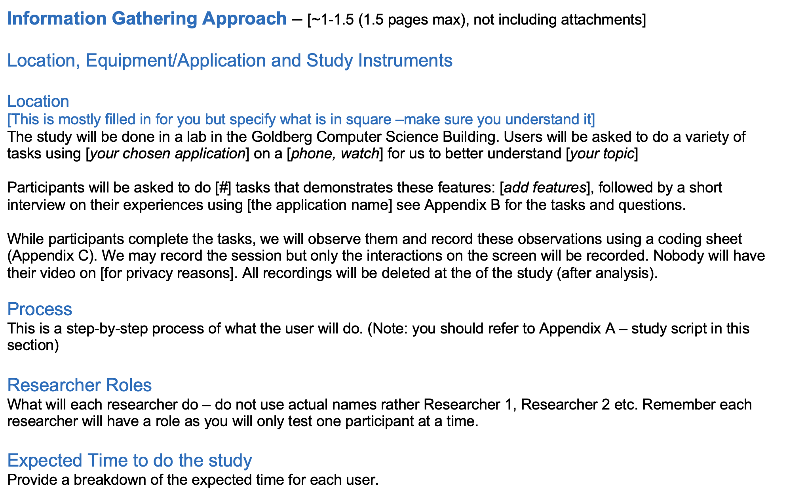
Section 3 -Info Gathering Approach (~1-1.5 pp)
This section provides information about where and how you will run the study
Lab 3 – Tasks & questions
and Post-study questions Use for the appendices for the MS

Slide 6
Location, equipment/app, instruments
The location of the study, equipment/application used and description of instruments (e.g., interview/ contextual inquiry)
Describe where the study will be located (e.g., the labs in the Computer Science building)
Equipment used (e.g., Smartphone, Smartwatch)
Briefly describe the application you will be using
Concisely explain what you will ask of the user (e.g., questions, observation tasks) and how you will record the answers and observations (e.g. use coding sheets – refer to Appendix C).
Do not repeat all the questions that are already included in the appendix – just give the reader an understanding about what things you want to ask and/or have the user do).

Slide 7
The Study Process and Role
The study process: This is a step-by-step explanation of what the user will do (e.g., from the moment of meeting with you, etc. For example:
The researchers describe the study (Appendix A)
The participant starts the [interview] (Appendix B) and may be asked to show how they currently do [------]
Once the participant has finished the interview, the researchers thank the participant
Researchers' roles: explain what each researcher will do so everyone has a part in the process.
Do not use actual names rather Researcher 1, Researcher 2
You should have a role for 4 researchers since when we run our study, one person will a 'user' for another group).
For example,
Researcher 1 will explain the study and answer questions at the start of the study.
Researcher 2 and 3 will record the answers of the study, etc.
note you can only do one interview/contextual inquiry at a time

Slide 8
Expected Time
Expected Time to do the study - provide a breakdown of expected time for each user. For example:
Note: Each interview/contextual inquiry should take ~15 minutes
1-2 minutes to introduce the researchers, topic and process, and answer any questions
10 minutes to go through the questions and observation tasks
2 minutes to thank users and answer any questions

Slide 9
Section 4 - References
Lab 1 – use references
(5) in ACM format

Slide 10
Appendices
Lab 3– This is mainly based on Lab3. Add info to appendices templates (tasks, interviews, coding sheet)
Appendices
Appendix A: Short introduction script that will be read to all users
Appendix B: Task list and task questions (post-task and post-study)
Appendix C: Coding sheets
Appendix D: Work breakdown
Each appendix should start on a new page!

Slide 11
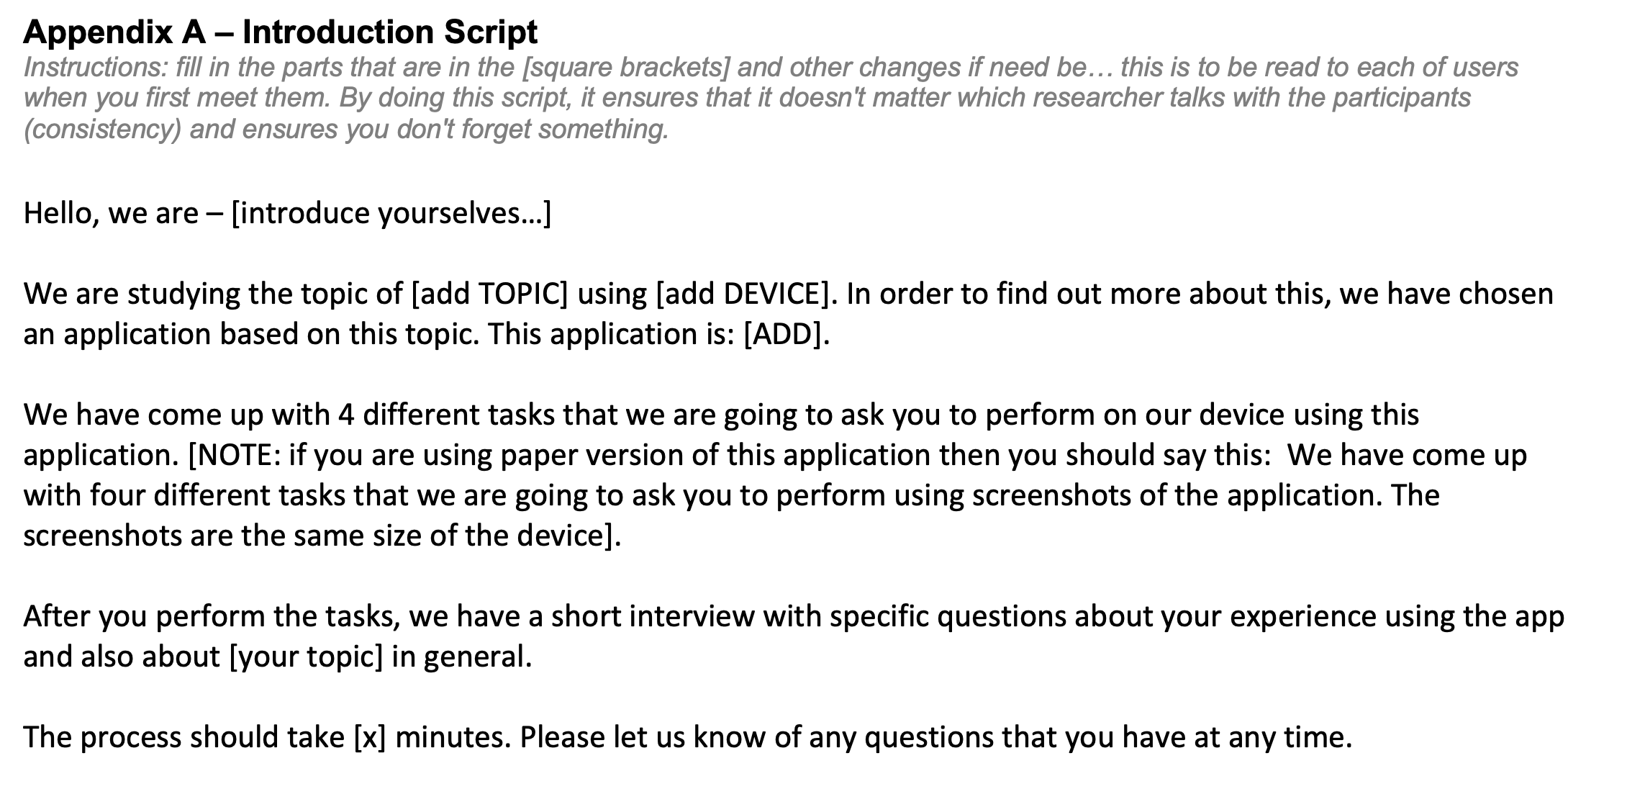
Appendix A: Study Script
Remember to remove the instructions under the heading before handing in MS1
Make sure to fill in missing information before handing in MS1
The script is read to every participant before they start the study. This ensures that everyone has the same instructions.

Slide 12
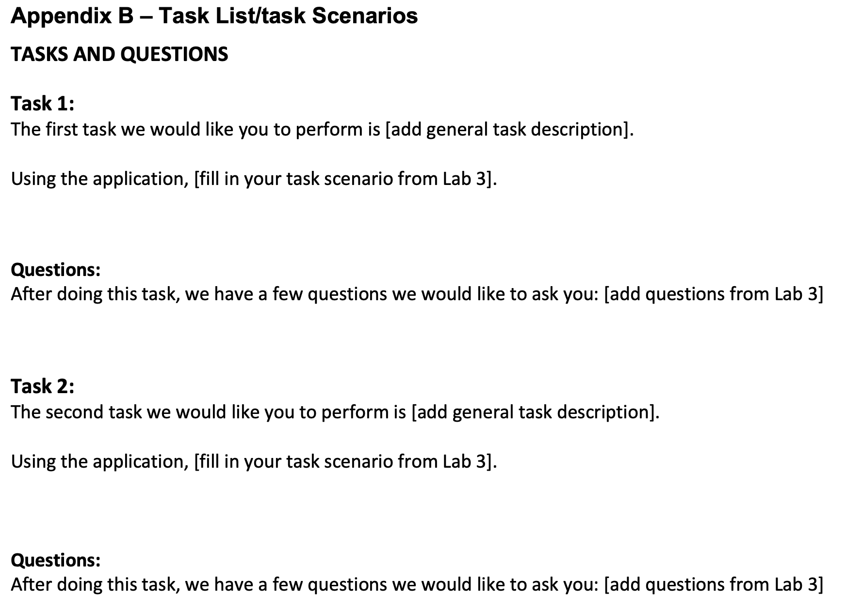
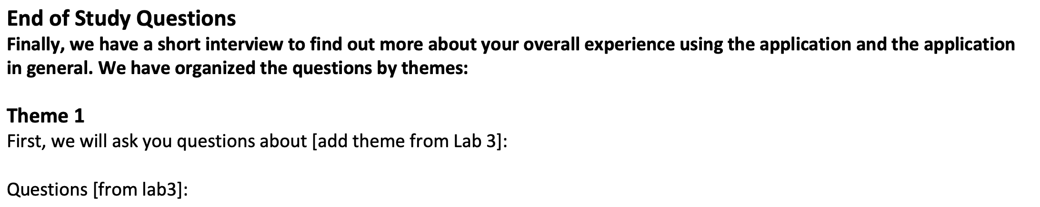
Appendix B: Tasks and Questions
Fill the four tasks and all task related questions from Lab3
Fill in post-study interview questions from Lab3

Slide 13
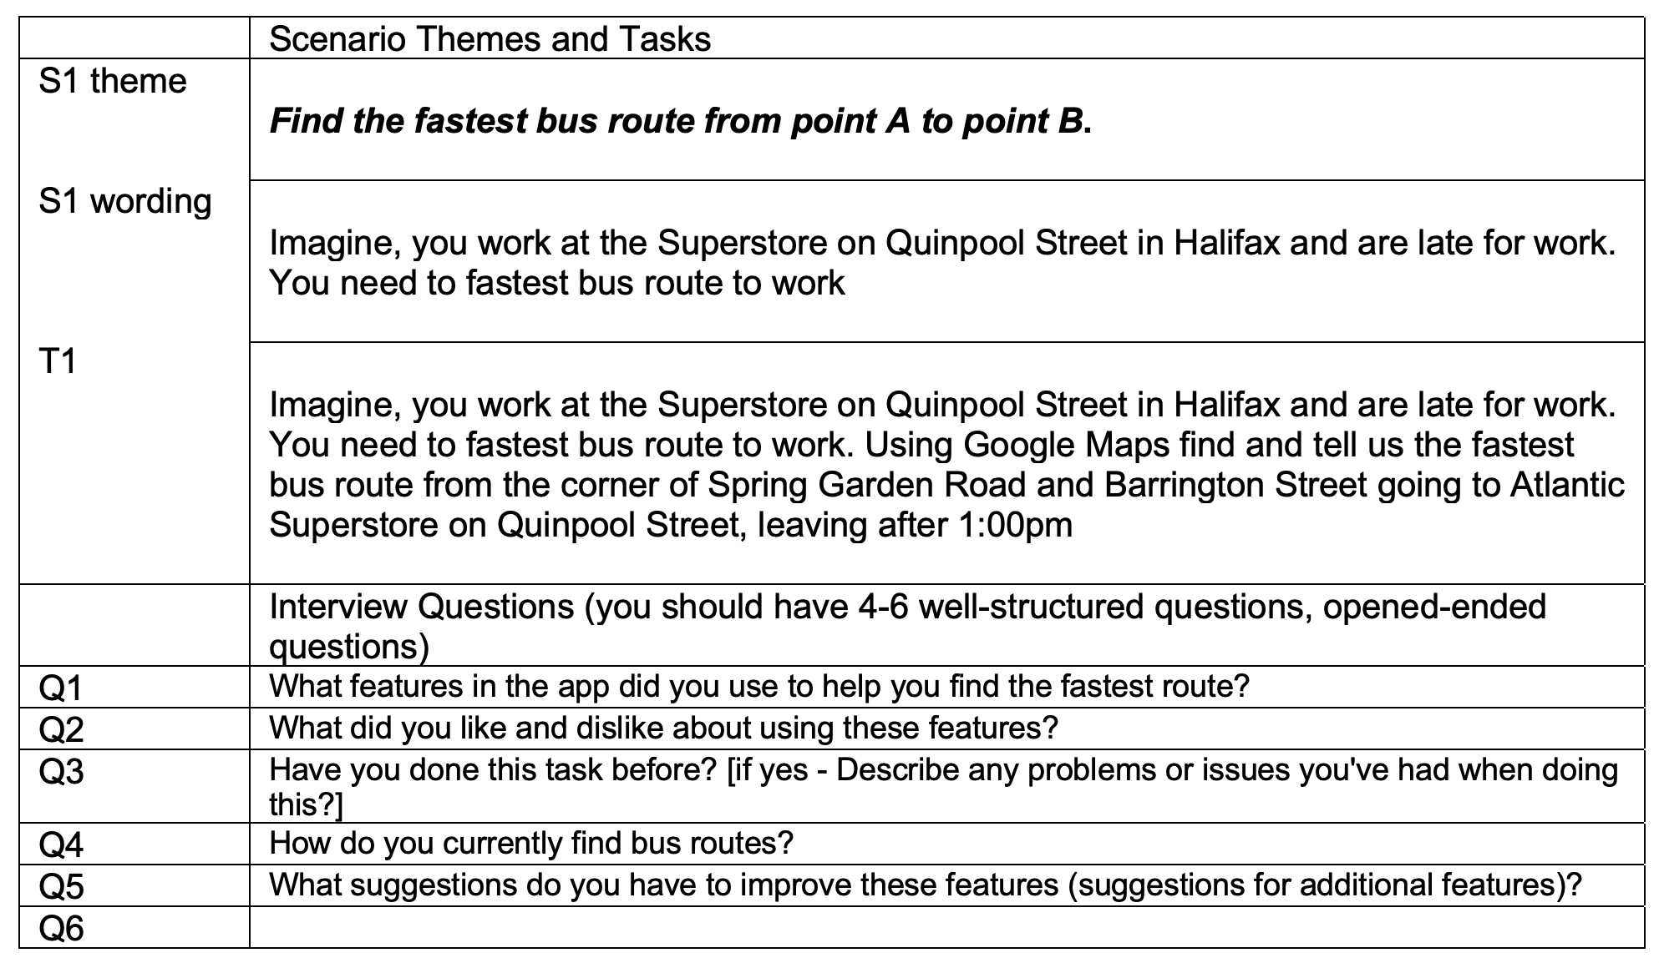
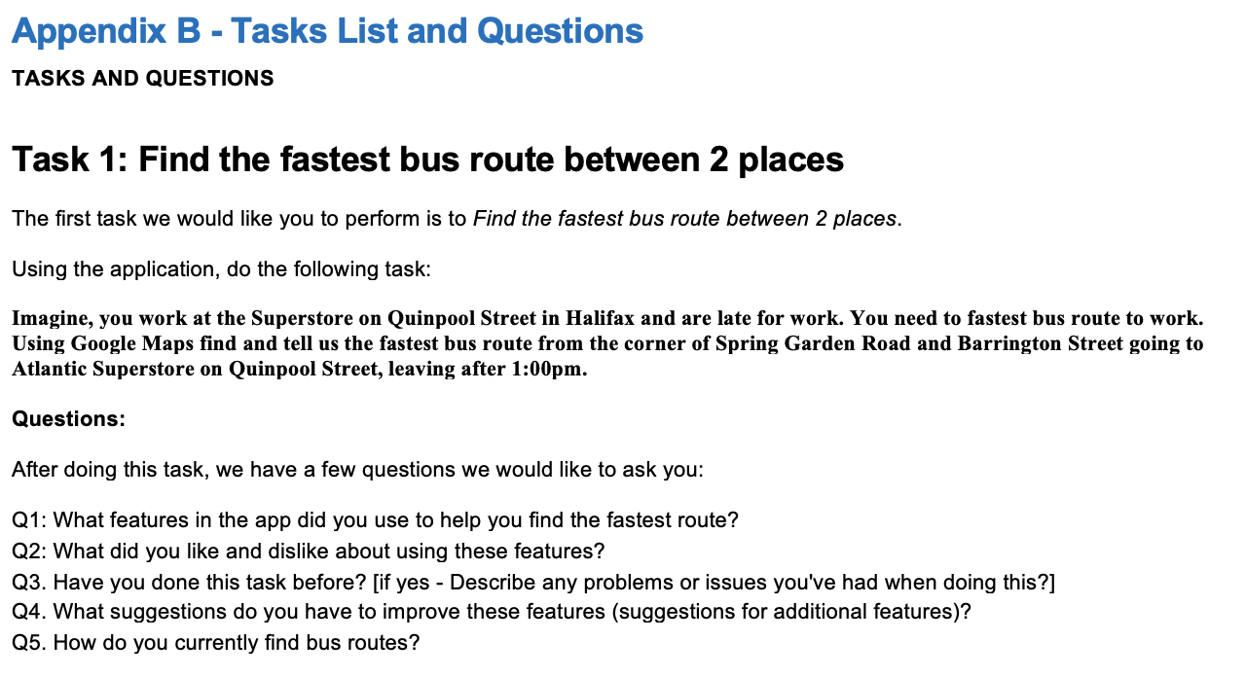
Appendix B - sample
Task 1 Example from Lab3
Task1 and Questions added to Appendix B

Slide 14
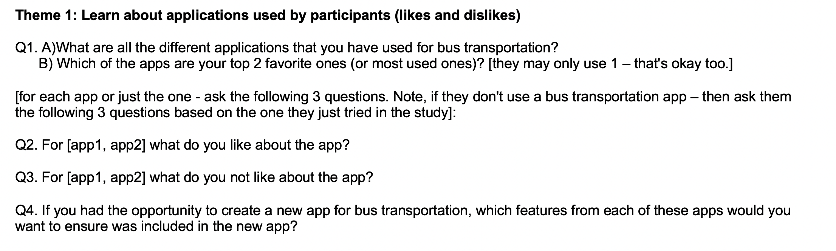
Appendix B - Sample
Themes and questions are added from Lab3
Post-Task Interview Questions
Notes:
You can have two parts to a single question (like Q1).
You can base the other questions from a previous answer (don't have to, but can)
You can write yourself notes to the questions in square brackets. That helps ensure you can adapt the question to potential different situations (which with open questions is a good idea)

Slide 15
Appendix C – Coding Sheet
For each participant, some of your team members will be recording observations of the user doing the tasks and make notes of the interview Q answers (that way you you only have to check recordings – not rely completely on it)
Each participant will be given a number (e.g., P1) and each member who is recording on the coding sheets will add this number to the sheet (and their own name). We do NOT use participants names anywhere in the study for confidentiality – THIS IS A MUST!
You will add your tasks, task questions and general interview questions to your coding sheet, with room for the researchers (your team) to make notes.

Slide 16
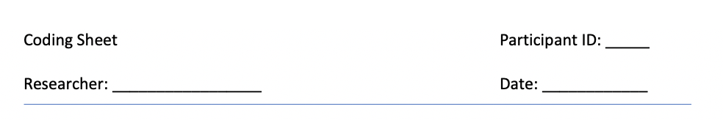
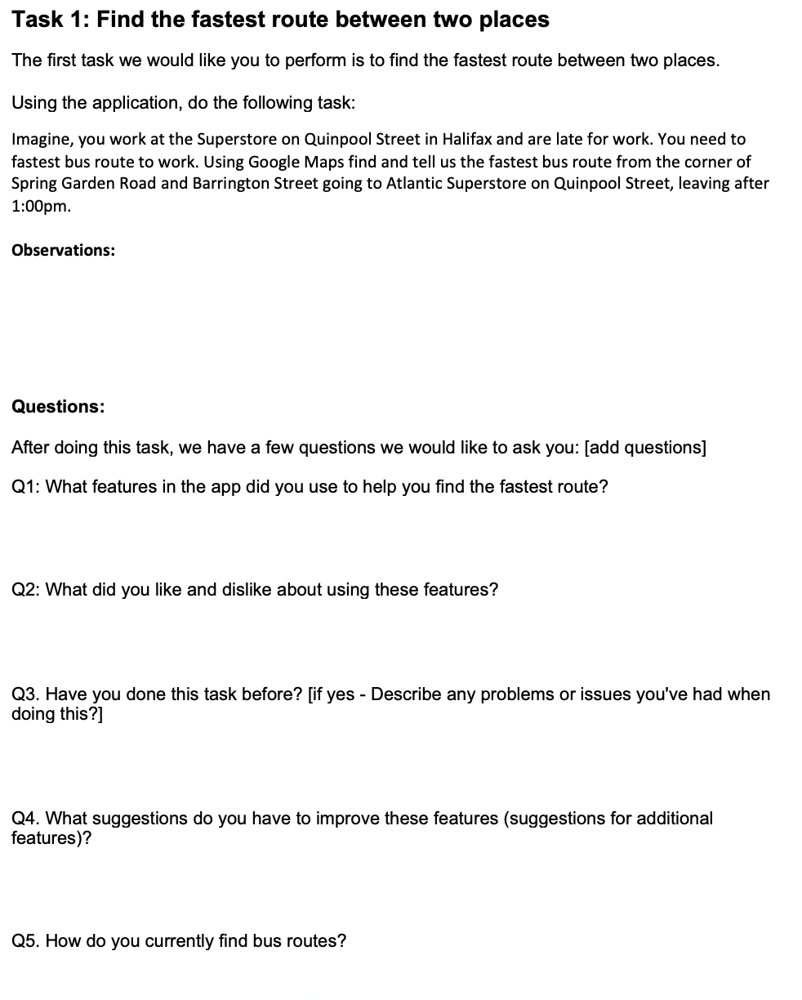
Appendix C - Sample
Room to add the Participant ID, researcher name and date at top
Add each Task (with room to add 'Observations') and leave room to add comments/notes under each task question

Slide 17
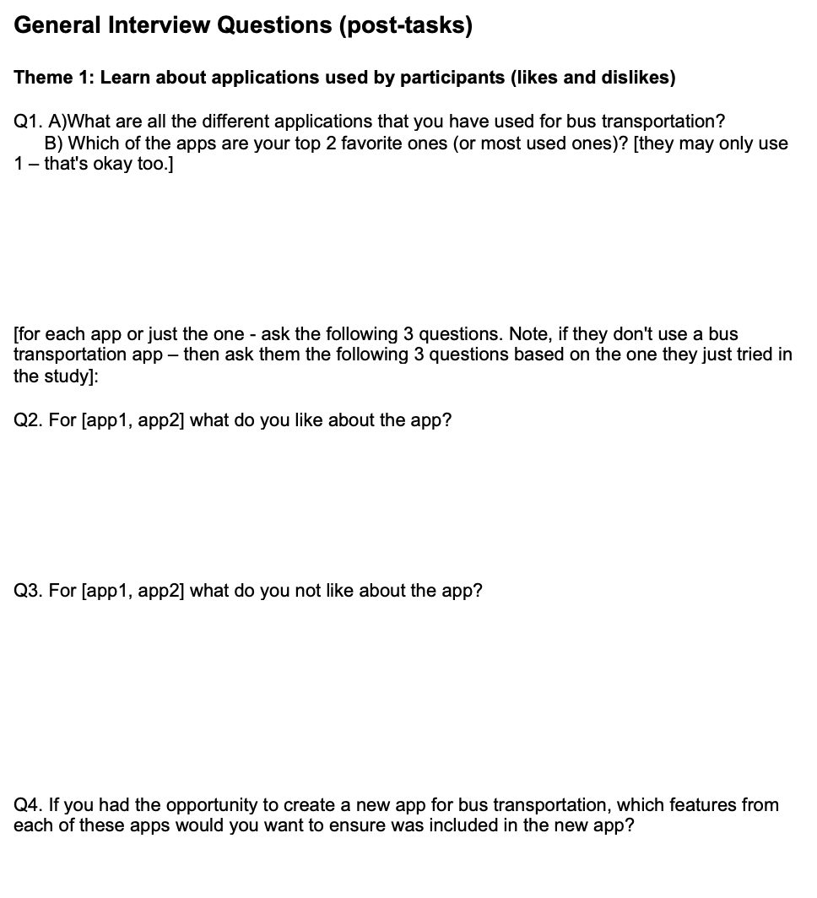
Appendix C - Sample
Room to add the Participant ID, researcher name and date at top
Add the General Post-Task Interview Questions and leave room to add comments/notes under each question

Slide 18
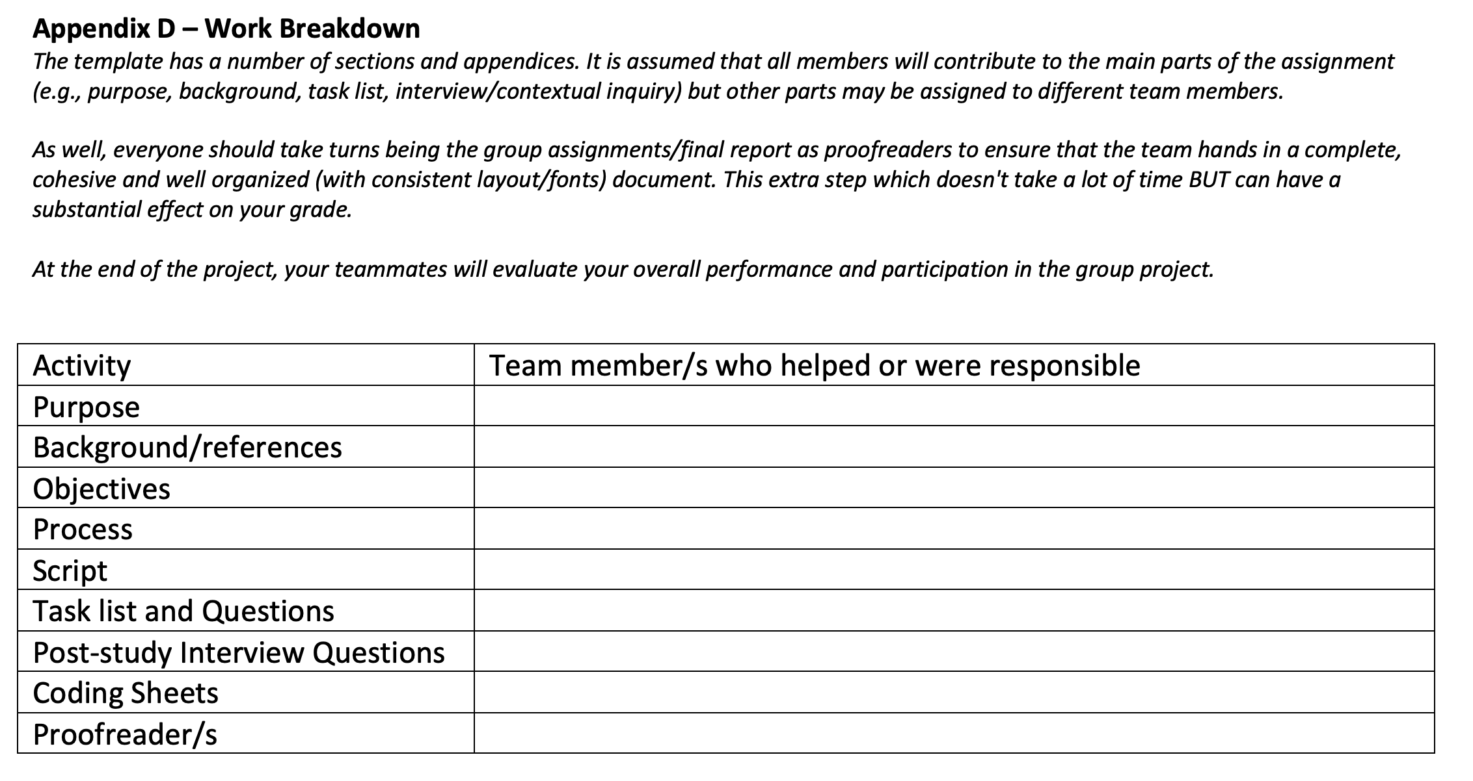
Appendix D – Work breakdown
Remove instructions under the heading before handing in MS1
Add member names, you can have more than one name for topic and members will most likely be listed more than once

Slide 19
Study Plan
Lab 4 (Oct 12) is reserved time that your group can make final changes to the Milestone. Your TAs will be there to help and answer questions.
Pilot ('try out') one to two tasks and your post-study questions in class Oct. 17
We will have some time in class for you try out one to two of your tasks and ask some of your post-study questions (pick ones that you think may need some feedback)
I'll provide a list of 'users' at the start of the pilot. Everyone will get at least one 'trial user'
Full study – in lab Wednesday Oct. 19 – run full study during the full time with classmates

Slide 20
Piloting
When we run studies, we pilot our study materials and process.
Pilot data is not kept and analyzed but rather informs of changes that need to be made before the actual study (it's like a dress rehearsal). When you do the pilot, run it like your study. One researcher directs the users and asks the questions. The other researchers will fill in the observation sheets/coding sheets - making notes of not just user behaviour but problems with task descriptions/questions (good info).
After doing the pilot, you may realize that you need to make some small changes to make things clearer. For example,
Your participant may not understand a task description, so you can update it
You may need to revise some interview questions or even add couple extra questions/prompts because it is confusing.
Make your changes into the Appendix B + C from MS1 and re-submit highlighting just the changes in the appendices. A submission box will be created that you can use (if needed). Marks won't change – this is just an opportunity to practice and your study better which will make your analysis stronger and your project overall better.
Note: after you run the pilot tester through your study, you can outright ask them what they found confusing as well.

Slide 21
Actual Study (Wed. Oct 19)
This will be run similar to the pilot, but you will have ~3-4 participants to run (so time is important).
Your team need to be on time. You will have 10-15 minutes to get ready
We will post the schedule with names before the lab on our course Team
There will be 3-4 times to run users (we will do the forth round if we have time). We will assign users from each team for each run. During each run, 1 to 2 members of each team will be a user for another team (so when running the study, you will have 1 to 2 members less). Once that run is over, the user will return to their group and another member will be a 'user'
Again, we will have a schedule set up (you are not responsible for finding people).

Slide 22
For example: Actual Study
Below is a sample schedule (note only 3 teams and study runs are shown but the full schedule will show all 10 teams and up to 4 runs):
Run 1: 4:45-5:15
Run 2: 5:20-5:50
Run 3: 5:55-6:25
Group Blue
Name1
Name2
Name3
Name4
Group Green
Name1
Name2
Name3
Name4
Name5
Group Purple
Name1
Name2
Name3
Group Blue
Name1
Name2
Name3
Name4
Group Green
Name1
Name2
Name3
Name4
Name5
Group Purple
Name1
Name2
Name3
Group Blue
Name1
Name2
Name3
Name4
Group Green
Name1
Name2
Name3
Name4
Name5
Group Purple
Name1
Name2
Name3
Group Blue
Group Green
Group Purple
Group Blue
Group Green
Group Purple
Group Blue
Group Green
Group Purple
Notes: in Run 1, the first member of Team Blue will be a user/participant for Team Green, etc.
We will try to ensure that everyone has a chance to either be a pilot tester or actual user participant
There will be ~10 minutes between each run, so that the team can get ready for the next user

